Slide 1

Austin Animal Shelter Outcome Classification
John Tazioli
15JUN2022

Slide 2
Introduction
?
Which dogs are more likely to be euthanized than adopted at the Austin Animal Shelter?
Objective: Maximize number of dogs adopted, minimize dogs euthanized
Goals: Identify useful trends in shelter outcomes for dogs to guide allocation of limited funds

Slide 3
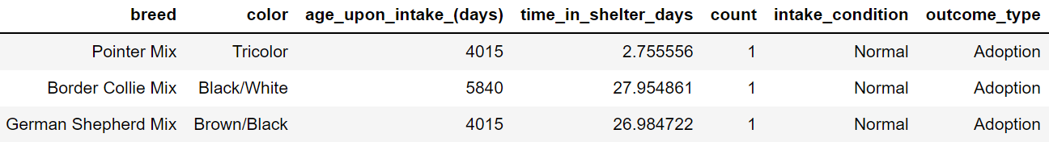
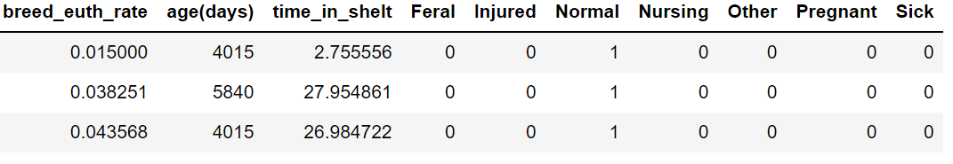
Methodology
# Euthanized | Total | Percent
1,411 | 21,989 | 6.4%
6,138 | 20,507 | 29.9%
Data
72,000 observations of animals and their outcomes, 2013-2018
https://www.kaggle.com/datasets/aaronschlegel/austin-animal-center-shelter-intakes-and-outcomes
Models:
Logistic Regression
Ensemble of Gaussian and Bernoulli Naïve Bayes
Tools
Data Cleaning: Excel and PANDAS
Modeling: scikit-learn and imbalanced-learn
Visualizations: Seaborn and MatPlotLib
1410
210

Slide 4
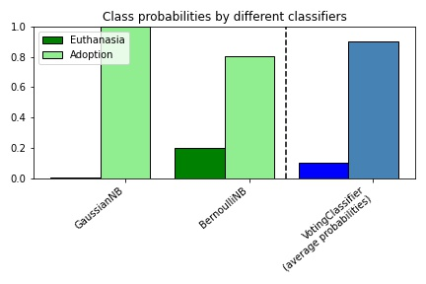
Results
Metrics:
Model | F1 | Incorrect Predictions (Adopt, Euthanize)
Baseline LogReg | 0.96 | 1411 (0, 1411)
Logistic Regression | 0.97 | 1235 (158, 1077)
Bernoulli Naïve Bayes | 0.95 | 610 (372, 238)
Gaussian Naïve Bayes | 0.94 | 662 (398, 264)
Voting Classifier | 0.96 | 558 (348, 210)

Slide 5
Conclusions
Breeds with Highest euthanization rates: pitbulls and terriers
Need the most marketing and outreach
Euthanized Dogs: 1410 days old, 14 days in shelter
Adopted Dogs: 702 days old, 24 days in shelter
People don’t want old dogs/old dogs have more ailments
Condition upon arrival: 94% normal status, 2.6% injured, 1% sick
Arrival condition not a good indicator of outcome

Slide 6
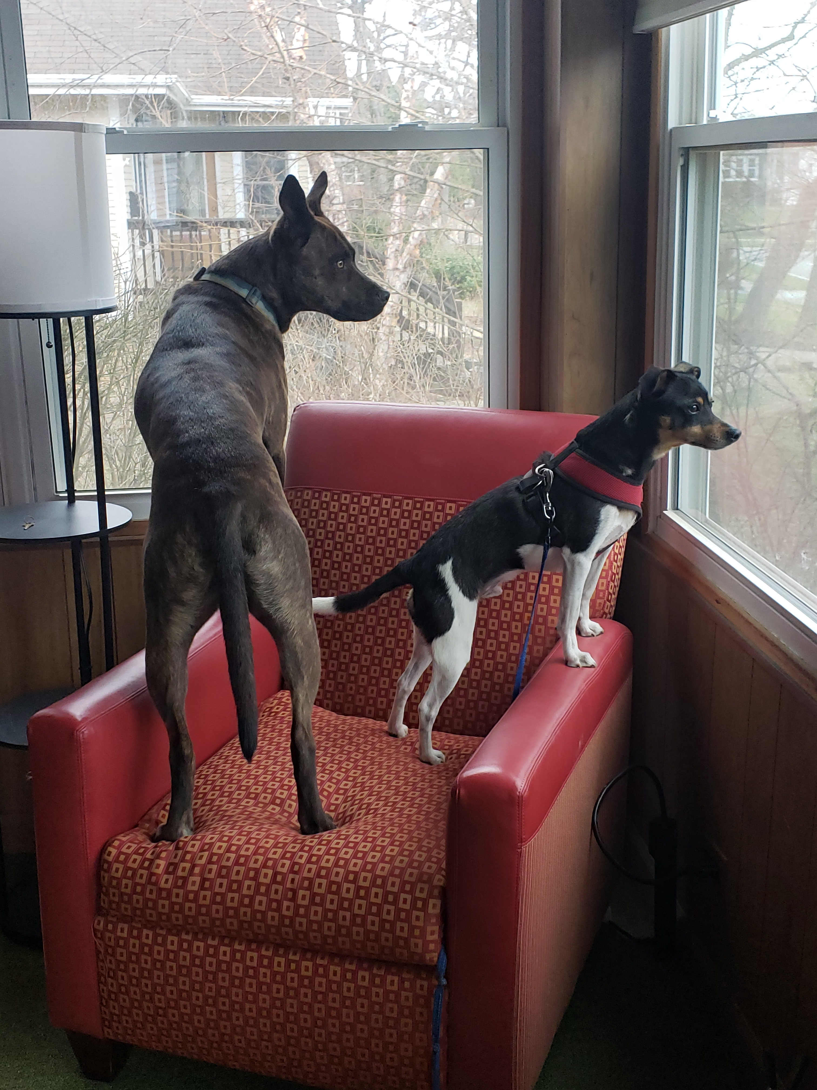
Future Work
Feature Engineering:
1410 breeds simplified
210 colors simplified
Voting Classifier weighting optimized
Add logistic regression to ensemble
Replace Voting classifier with Stacking classifier

